Slide 1
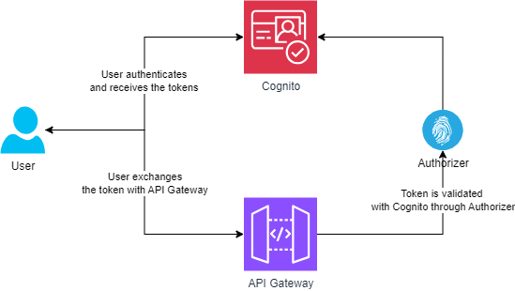
Cognito as Authoriser – High level Architecture

Slide 2
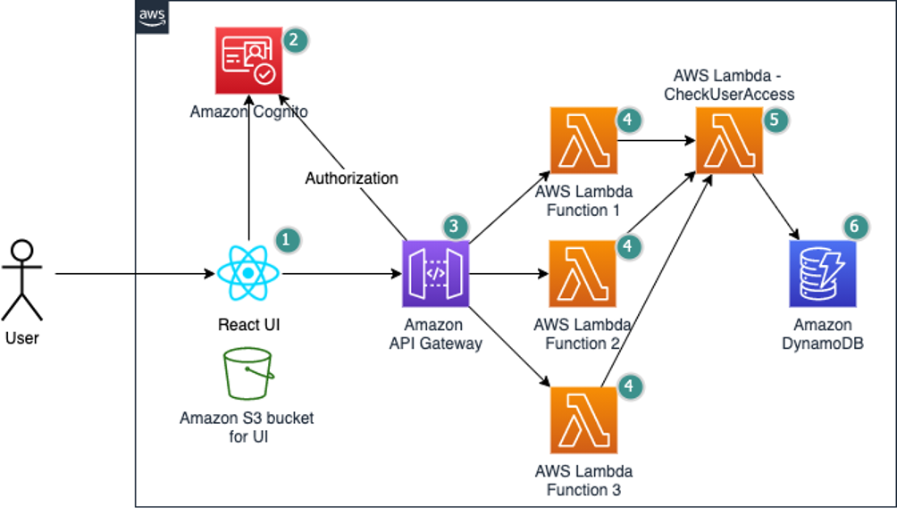
Fine grained authorization – High level Architecture

Slide 3
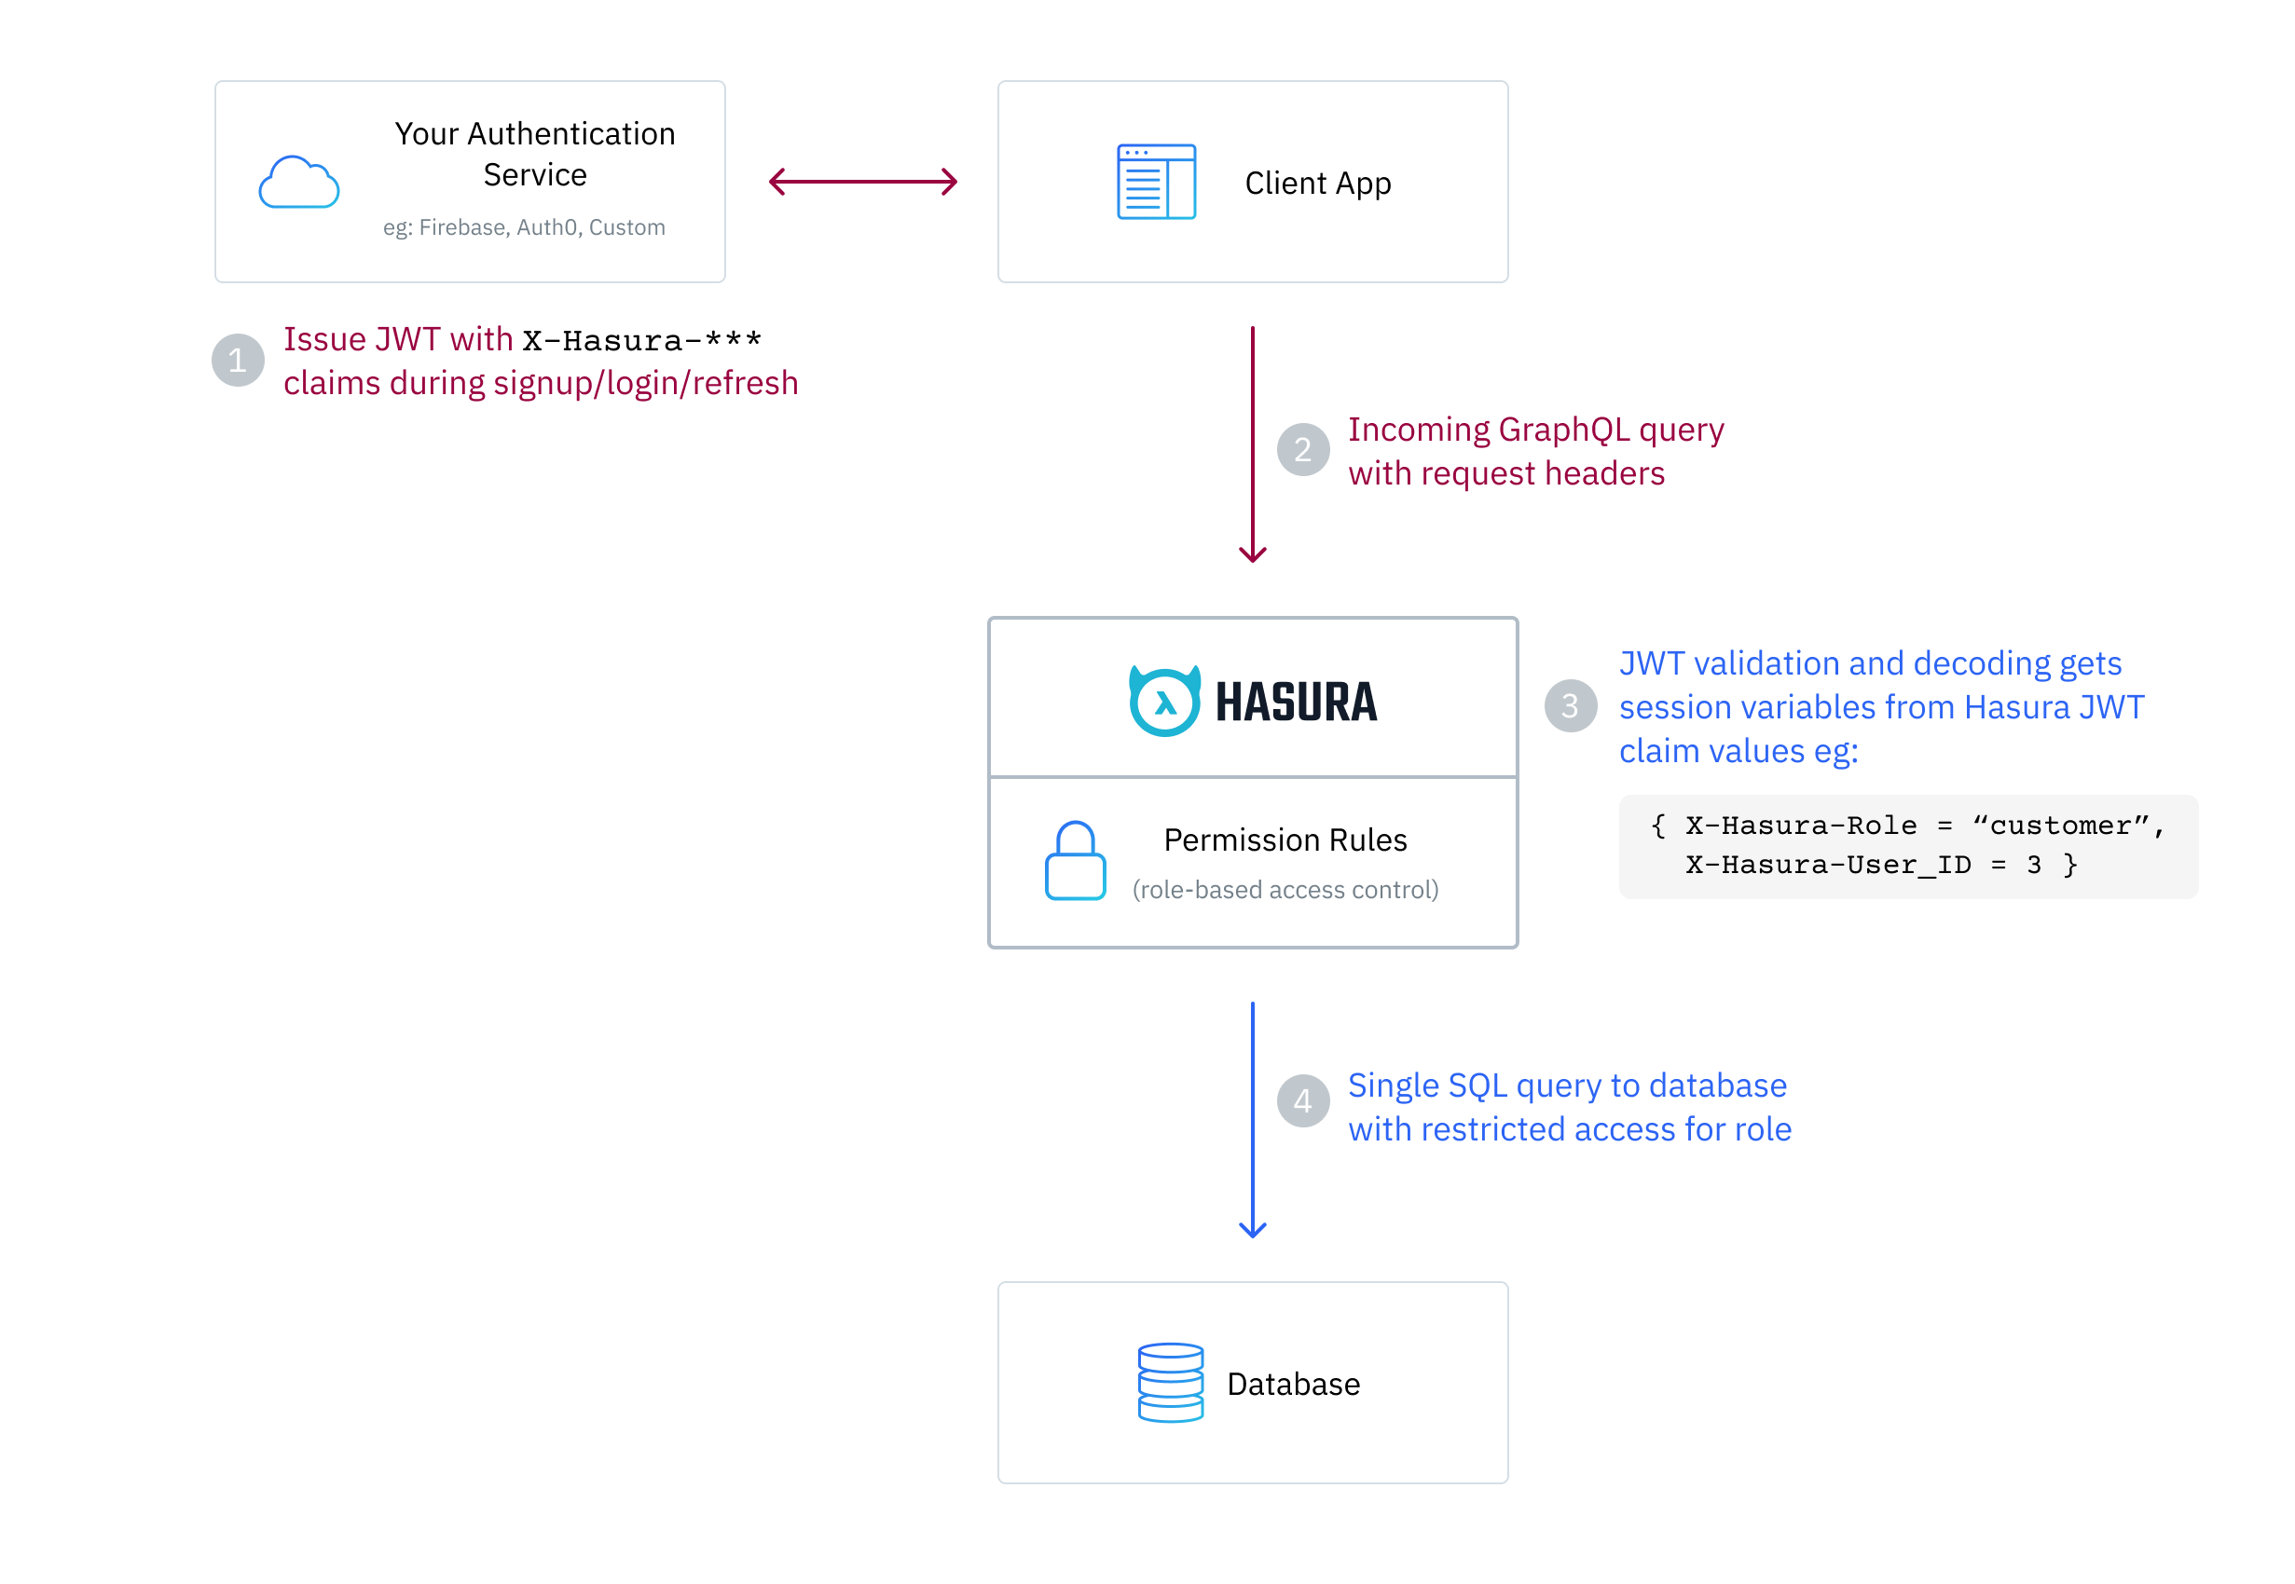
Hasura authentication

Slide 4
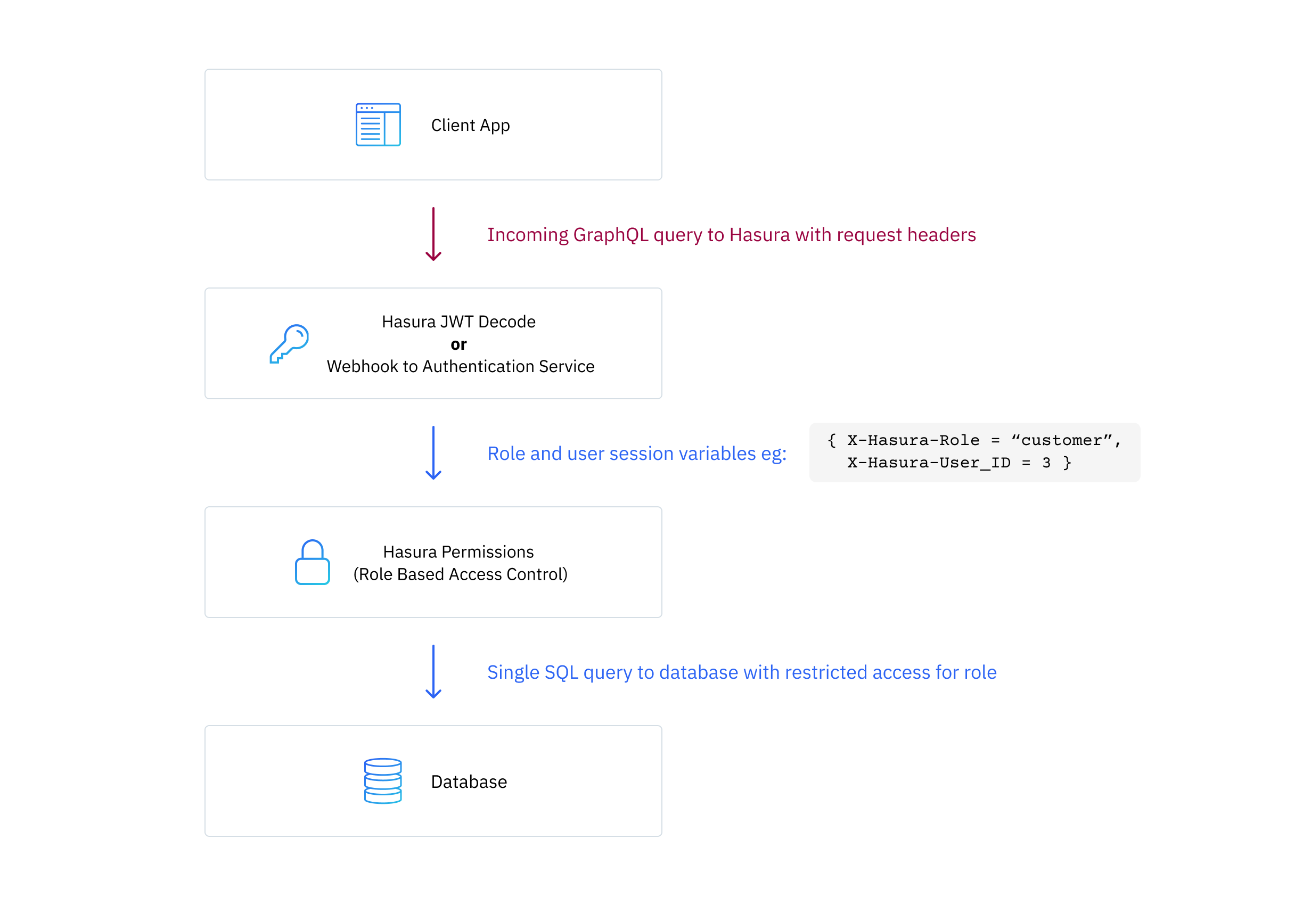
Hasura authentication

Slide 5
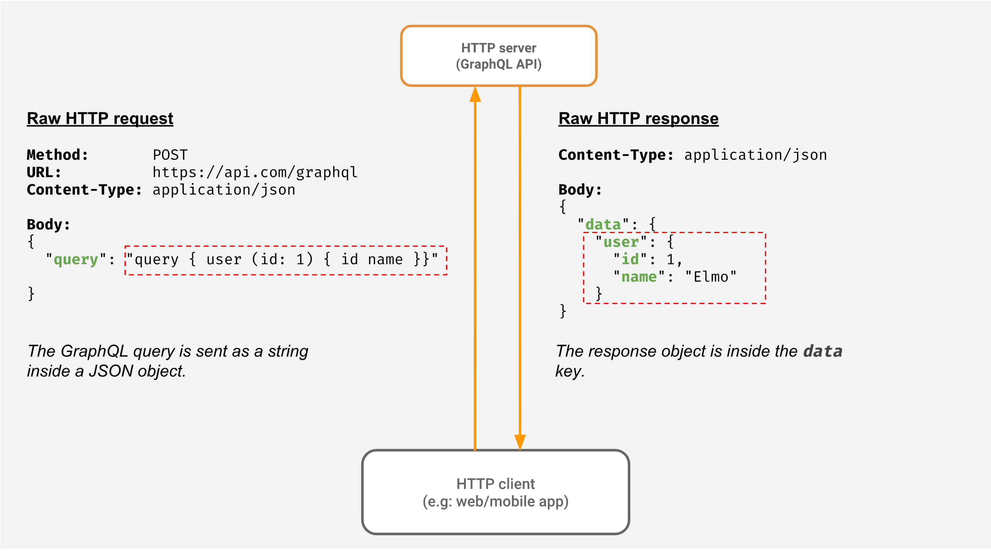
Hasura authentication

Slide 6
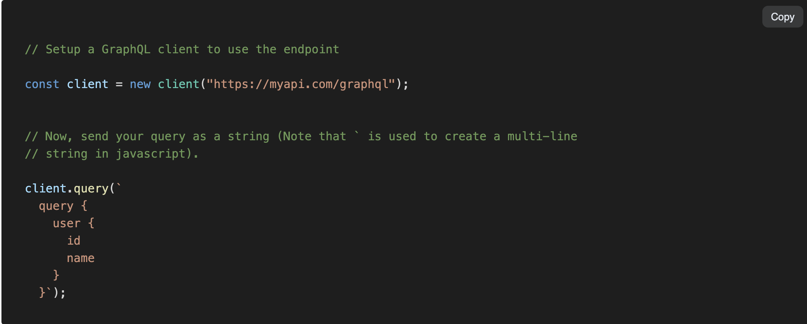
Hasura authentication

